Slide 1

Project Title – Doctor visits Analysis using python
Akhilesh Mandawgane

Slide 2

PROBLEM STATEMENT
Deal with the Dataset
To find the valuable insights from the dataset
Predict Future Healthcare Needs

Slide 3
Project Description :- In this project we find the valueable aspect of healthcare. Such as the relation between income and visits , visualization of plot graphs and perncentage of people getting the insurance etc.

Slide 4

WHO ARE THE END USERS?
Doctor and nurse
Medical Administrators
Insurance Company

Slide 5

Technology Used
Python
Matplotlib library
Seaborn library
Use of NumPy , Pandas

Slide 6
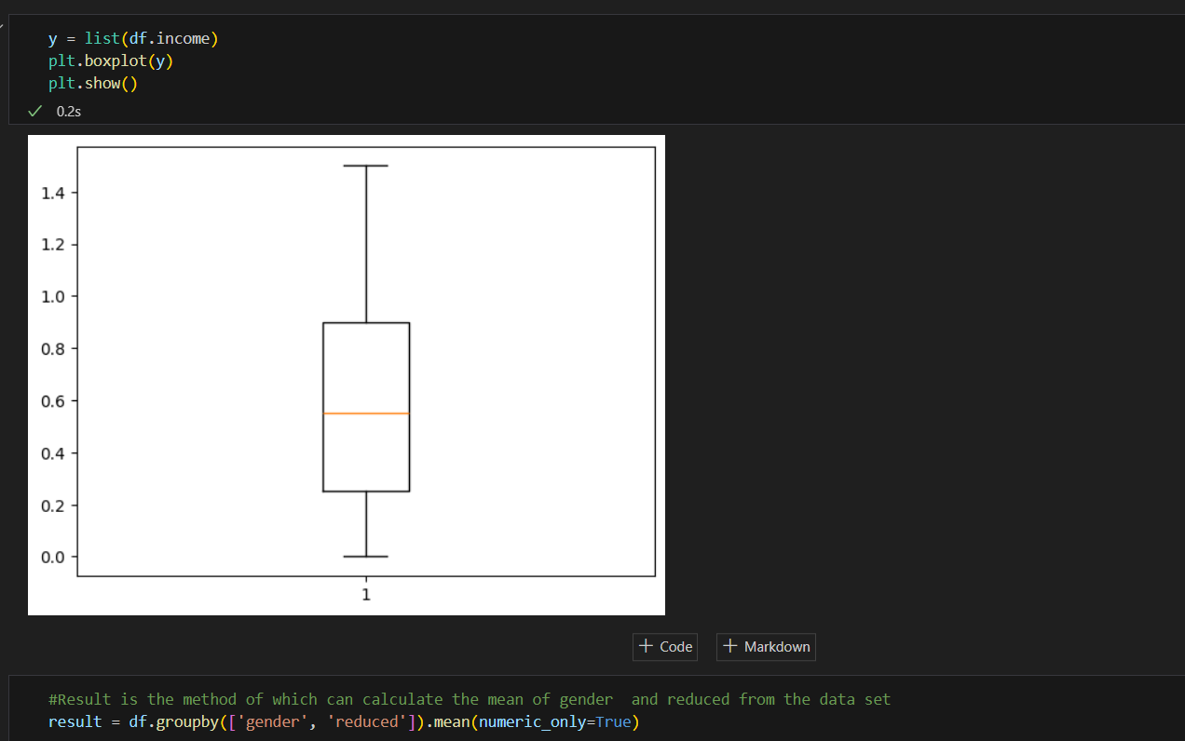
RESULTS
.
Project link

Slide 7
Thank you
.
.

